Slide 1
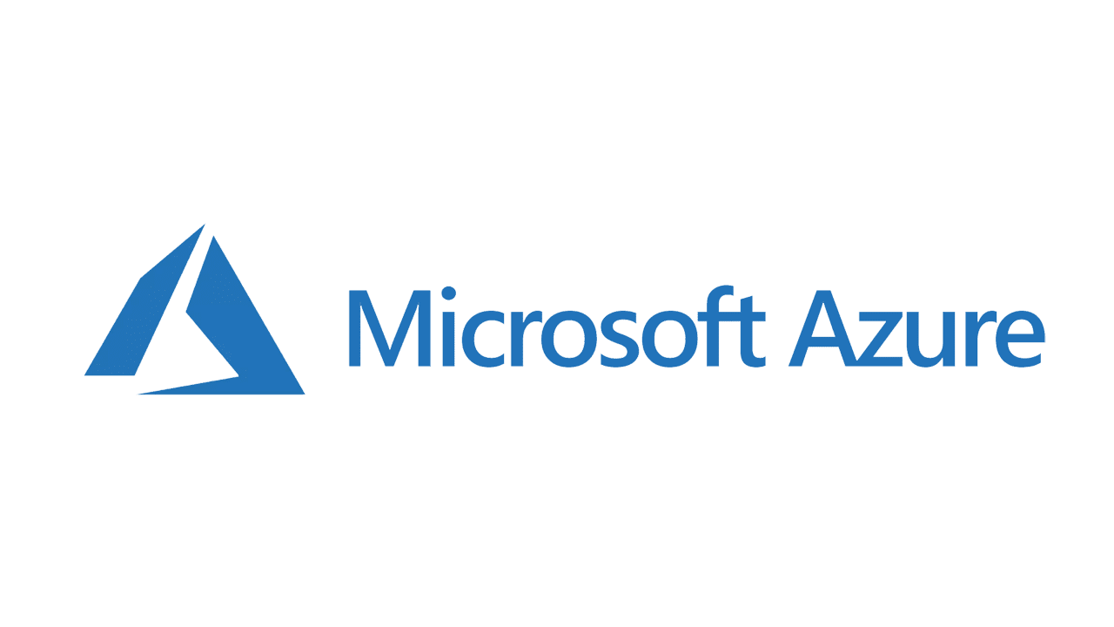

Slide 2
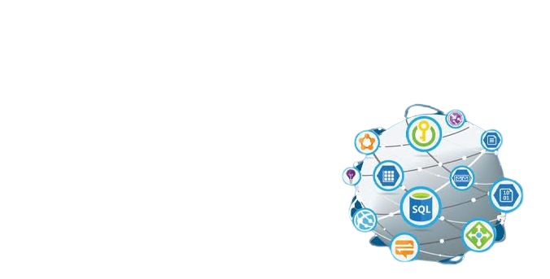
What is Azure?
Cloud Computing Platform
200 products and cloud services
- Lie under IaaS PaaS & SaaS

Slide 3
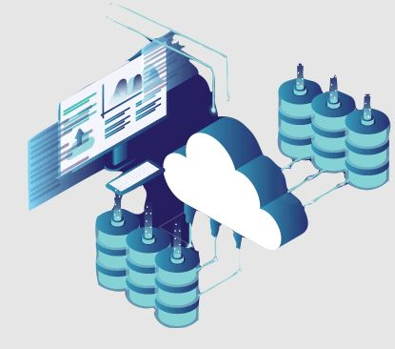
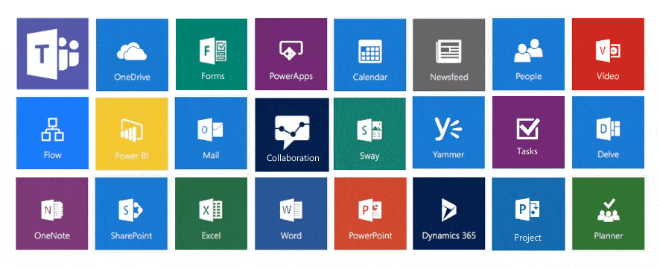
Azure & SaaS
Microsoft responsible for managing everything
Software delivered via the internet
User responsible for configuring the SaaS solution
User only needs to login and access

Slide 4
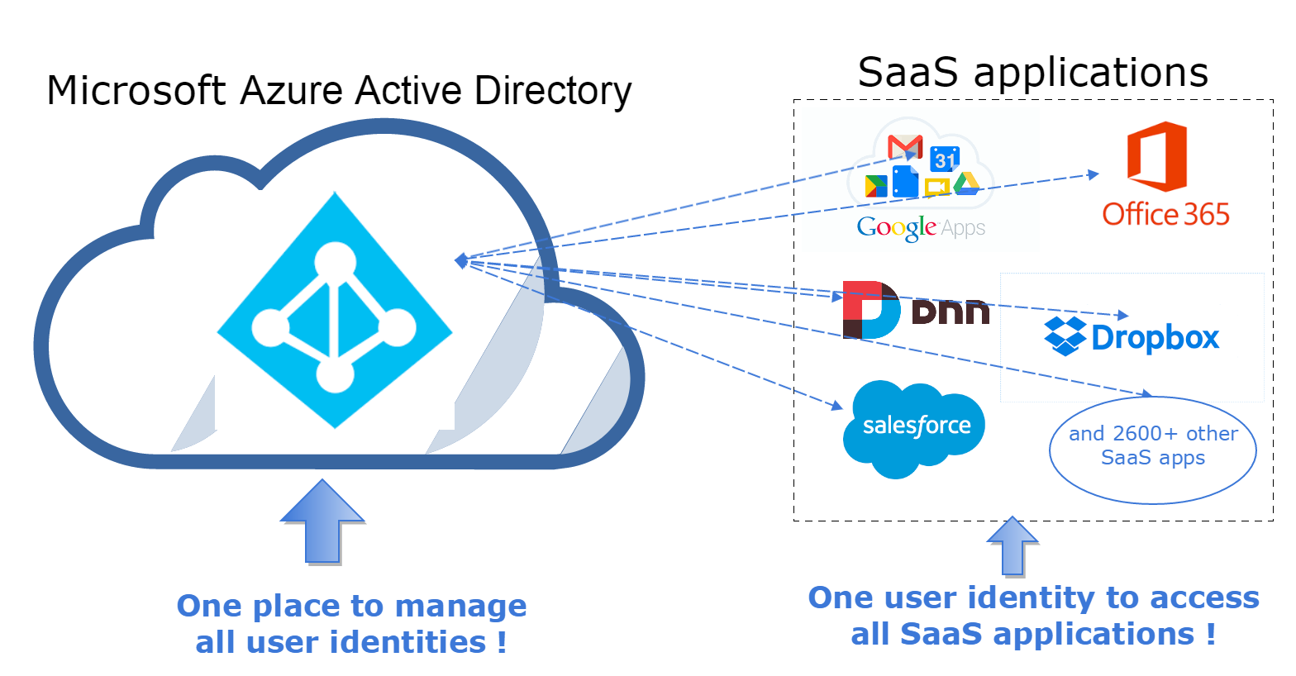

Slide 5
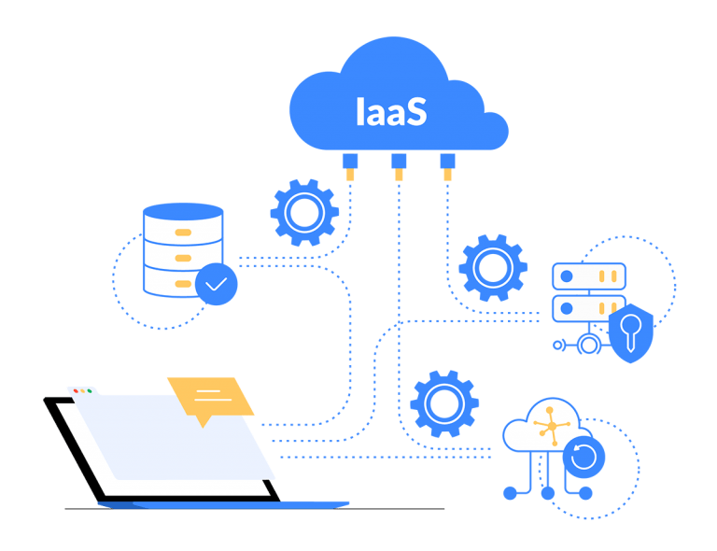
IaaS on Azure
Outsourcing all network & computing needs to Microsoft
Removing all infrastructure & basing it on Microsoft’s end
Offering massive range of IaaS facilities depending on the needs
Hassle free

Slide 6
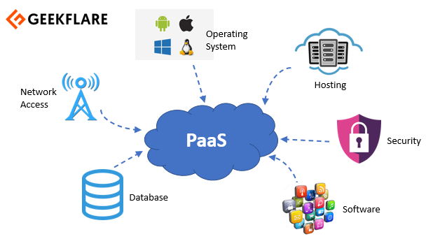
PaaS on Azure
Help user implement a cloud-powered development platform
Give developers total control over their application
Freedom to work on building
Safe in the knowledge that things like operating system patches or load balancing will just work.

Slide 7
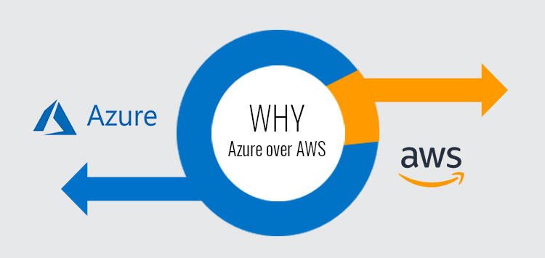
Why Azure?
Why not AWS?

Slide 8
Price ! That’s it

Slide 9
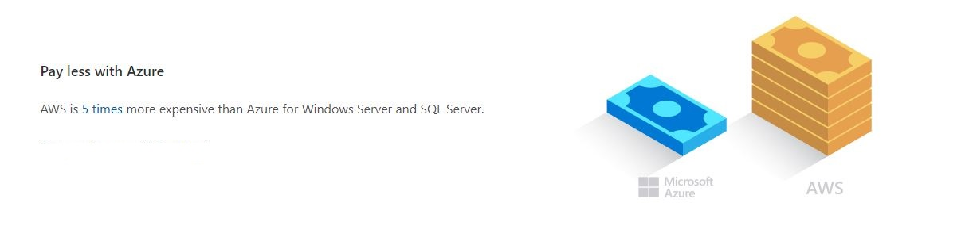

Slide 10
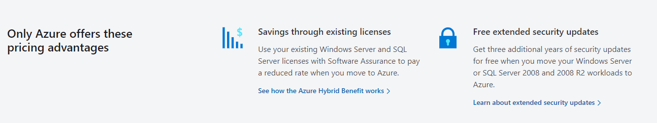

Slide 11
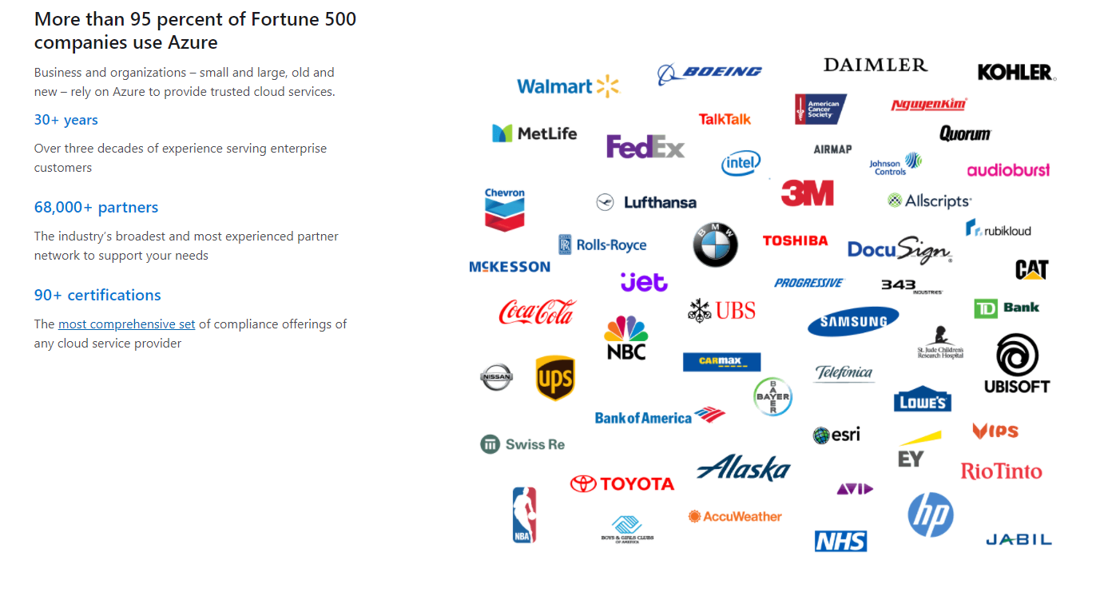

Slide 12
Let’s move to Demo

